Slide 1
The general level of difficulty of question increases… A “What is?” question is normally easier to create and answer than a “How might?” question.
Notes:
Deeper questioning and anticipated deeper response is developed from top left to bottom right.
Get pupils to come up with their own questions by choosing a word from the left-most column followed by a word from the top row.
Eg.
What Is… the time / the name of… etc
When Will… the reaction stop if I use X grams of Y?
How Might… we use photosynthesis to overcome the impact of burning fossil fuels?
ActiveX stuff and design by Jon Haines @mr_haines
Inspired by and thanks to @johnsayers

Slide 2
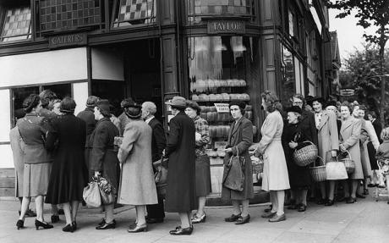
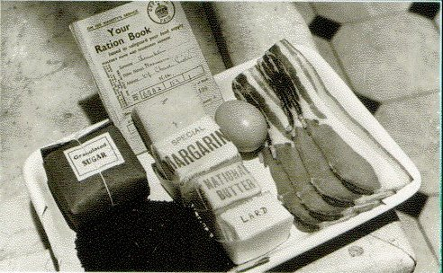
History / PSD
Notes:
Deeper questioning and anticipated deeper response is developed from top left to bottom right.
Get pupils to come up with their own questions by choosing a word from the left-most column followed by a word from the top row.
Eg.
What Is… the time / the name of… etc
When Will… the reaction stop if I use X grams of Y?
How Might… we use photosynthesis to overcome the impact of burning fossil fuels?
ActiveX stuff and design by Jon Haines @mr_haines
Inspired by and thanks to @johnsayers

Slide 3
What is this scene showing?
What did the people living in this period have to eat?
Where is this currently happening?
When has this happened in the UK?
When will this kind of famine happen again?
Which of the types of food should the families eat more of?
Who might solve problems like this?
Why should we care about what happened in the past?
Why would knowing about the past help us in the future?
Why might this happen again in the UK?
How did this affect the size of the population?
How should we use this information?
Notes:
Deeper questioning and anticipated deeper response is developed from top left to bottom right.
Get pupils to come up with their own questions by choosing a word from the left-most column followed by a word from the top row.
Eg.
What Is… the time / the name of… etc
When Will… the reaction stop if I use X grams of Y?
How Might… we use photosynthesis to overcome the impact of burning fossil fuels?
Project and post questions using Post-It Notes or use the type on slide if you have macros enabled on your computer!
ActiveX stuff and design by Jon Haines @mr_haines
Inspired by and thanks to @johnsayers

Slide 4
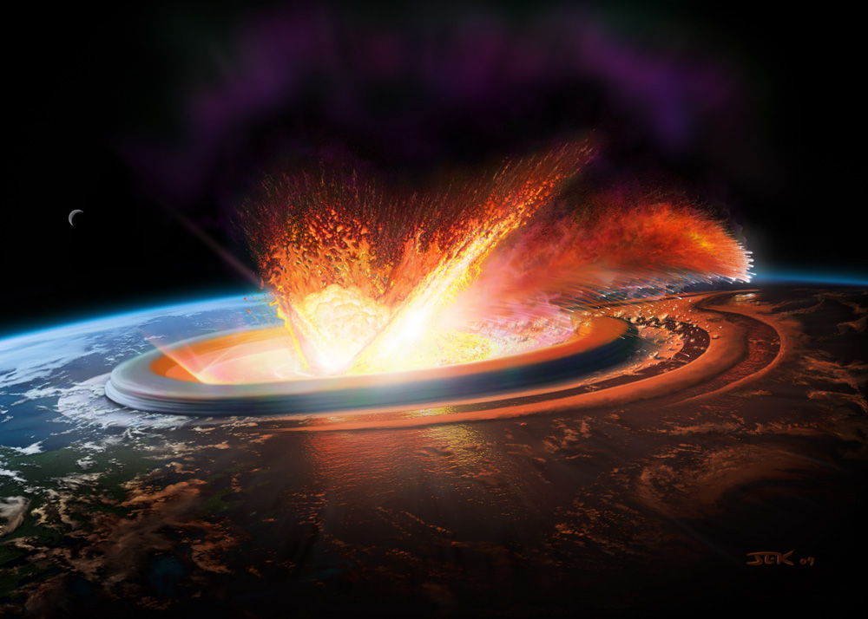
Science
Notes:
Science – Asteroids / Satellites / Extinction / Prediction / Evidence etc etc
Deeper questioning and anticipated deeper response is developed from top left to bottom right.
Get pupils to describe a variety of aspects of the photo through developing and asking quality questions and encouraging quality dialogue.
Come up with questions by choosing a word from the left-most column followed by a word from the top row.
Eg.
What Is… happening?
How Could… this affect the future of the Earth?
How Will… this affect the Earth’s atmosphere?
Why might… we be unaware that this is about to happen?
How Might… humans survive?
ActiveX stuff and design by Jon Haines @mr_haines
Inspired by and thanks to @johnsayers

Slide 5
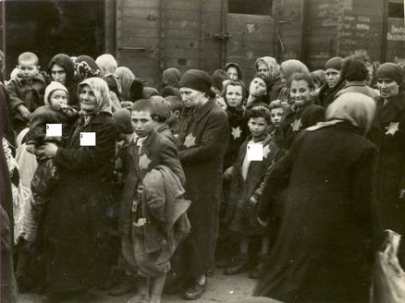
History / PSD
Notes:
History – The Holocaust / War / Anti-semitism / Civil Liberties / Civil Rights
Deeper questioning and anticipated deeper response is developed from top left to bottom right.
Get pupils to describe a variety of aspects of the photo through developing and asking quality questions and encouraging quality dialogue.
Come up with questions by choosing a word from the left-most column followed by a word from the top row.
Eg.
What Is… happening?
Where Did… they get taken?
Why Might… they be unaware of the dangers ahead?
Why Did… they get treated like this?
ActiveX stuff and design by Jon Haines @mr_haines
Inspired by and thanks to @johnsayers

Slide 6
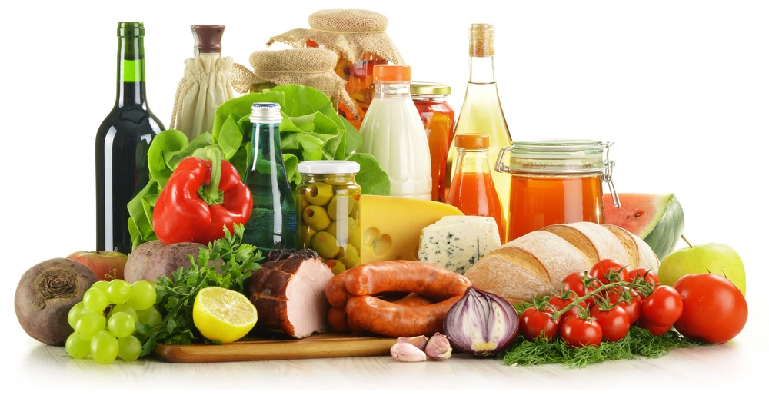
MFL / Science / Food Tech
Notes:
Deeper questioning and anticipated deeper response is developed from top left to bottom right.
Get pupils to describe a variety of aspects of the photo through developing and asking quality questions and encouraging quality dialogue.
Come up with questions by choosing a word from the left-most column followed by a word from the top row.
Eg.
What Is…
How Could…
How Will…
Why might…
How Might…
ActiveX stuff and design by Jon Haines @mr_haines
Inspired by and thanks to @johnsayers

Slide 7
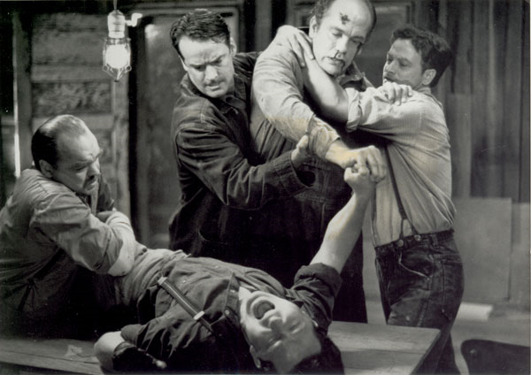
English
Notes:
English – Of Mice & Men
Deeper questioning and anticipated deeper response is developed from top left to bottom right.
Get pupils to describe a variety of aspects of the photo through developing and asking quality questions and encouraging quality dialogue.
Come up with questions by choosing a word from the left-most column followed by a word from the top row.
Eg. Scene from Of Mice & Men
What is happening?
Why is this happening?
How might he be feeling?
Which of the characters do you sympathise with?
Why do you sympathise with them?
ActiveX stuff and design by Jon Haines @mr_haines
Inspired by and thanks to @johnsayers

Slide 8
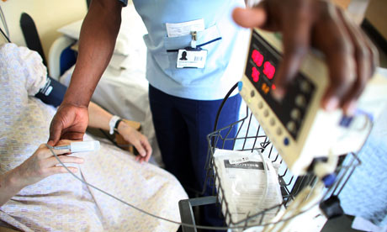
Health/ Social Care
Notes:
Health & Social Care – Professionalism / Skills / Relationships / Caring / Treatment / Aid / Help / Assistance
Deeper questioning and anticipated deeper response is developed from top left to bottom right.
Get pupils to describe a variety of aspects of the photo through developing and asking quality questions and encouraging quality dialogue.
Come up with questions by choosing a word from the left-most column followed by a word from the top row.
Eg. Scene from Of Mice & Men
What is happening?
Why is this happening?
What will happen if the patient’s pulse is too high?
How might the patient be feeling?
ActiveX stuff and design by Jon Haines @mr_haines
Inspired by and thanks to @johnsayers

Slide 9
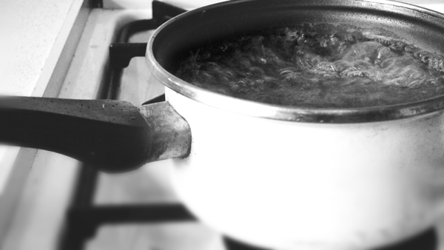
Science
Notes:
Deeper questioning and anticipated deeper response is developed from top left to bottom right.
Get pupils to describe a variety of aspects of the clip / photo through developing and asking quality questions and encouraging quality dialogue.
Come up with questions by choosing a word from the left-most column followed by a word from the top row.
Eg.
What Is happening?
What Could I use to measure the temperature?
When Did you last see this happening?
How Could this be encouraged to happen quicker? How Could this be dangerous?
Why Is the water bubbling? What Are the bubbles?
How Might we model how the bubbles are made?
ActiveX stuff and design by Jon Haines @mr_haines
Inspired by and thanks to @johnsayers

Slide 10
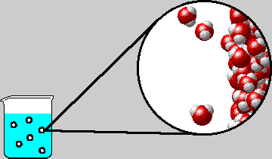
Science
Notes:
Deeper questioning and anticipated deeper response is developed from top left to bottom right.
Get pupils to describe a variety of aspects of the clip / photo through developing and asking quality questions and encouraging quality dialogue.
Come up with questions by choosing a word from the left-most column followed by a word from the top row.
Eg.
What Is…
How Could…
How Will…
Why might…
How Might…
ActiveX stuff and design by Jon Haines @mr_haines
Inspired by and thanks to @johnsayers

Slide 11
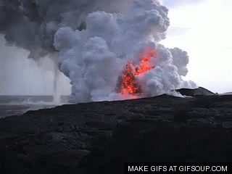
Science / Geog.
Notes:
Deeper questioning and anticipated deeper response is developed from top left to bottom right.
Get pupils to describe a variety of aspects of the clip / photo through developing and asking quality questions and encouraging quality dialogue.
Come up with questions by choosing a word from the left-most column followed by a word from the top row.
Eg.
What Is…
How Could…
How Will…
Why might…
How Might…
ActiveX stuff and design by Jon Haines @mr_haines
Inspired by and thanks to @johnsayers

Slide 12
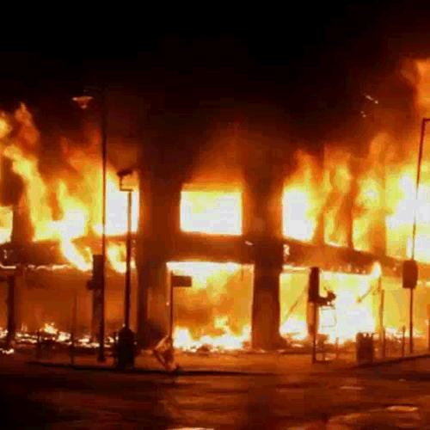
PSD / SMSC
Notes:
Personal & Social Development / Spiritual, Moral, Social & Cultural Development – Riot aftermath
Deeper questioning and anticipated deeper response is developed from top left to bottom right.
Get pupils to describe a variety of aspects of the clip / photo through developing and asking quality questions and encouraging quality dialogue.
Come up with questions by choosing a word from the left-most column followed by a word from the top row.
Eg.
What Is…
How Could…
How Will…
Why might…
How Might…
ActiveX stuff and design by Jon Haines @mr_haines
Inspired by and thanks to @johnsayers

Slide 13
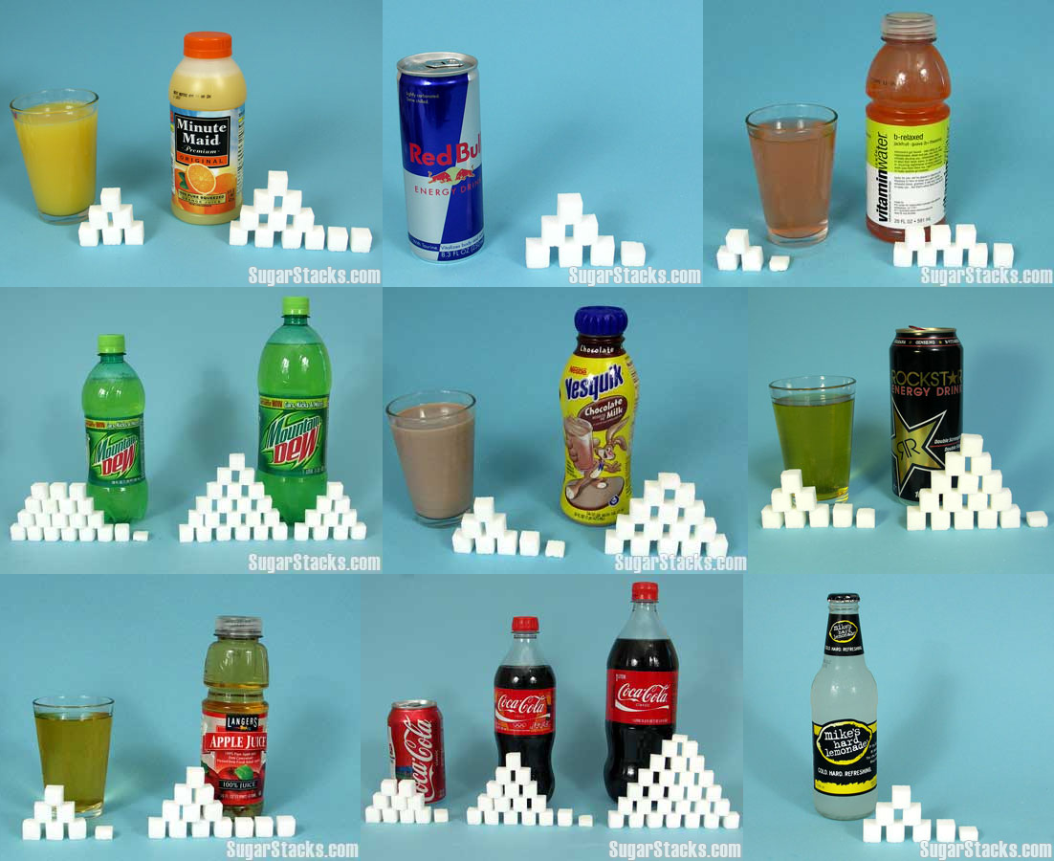
Food Tech / Science / PE
Notes:
Deeper questioning and anticipated deeper response is developed from top left to bottom right.
Get pupils to describe a variety of aspects of the photo through developing and asking quality questions and encouraging quality dialogue.
Come up with questions by choosing a word from the left-most column followed by a word from the top row.
Eg.
What Is…
How Could…
How Will…
Why might…
How Might…
ActiveX stuff and design by Jon Haines @mr_haines
Inspired by and thanks to @johnsayers

Slide 14
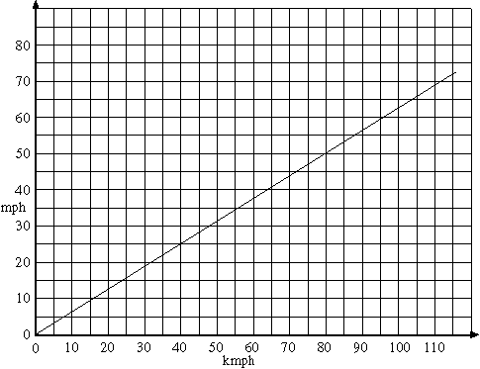
Maths
Notes:
Deeper questioning and anticipated deeper response is developed from top left to bottom right.
Get pupils to describe a variety of aspects of the photo through developing and asking quality questions and encouraging quality dialogue.
Come up with questions by choosing a word from the left-most column followed by a word from the top row.
Eg.
What Is…
How Could…
How Will…
Why might…
How Might…
ActiveX stuff and design by Jon Haines @mr_haines
Inspired by and thanks to @johnsayers

Slide 15
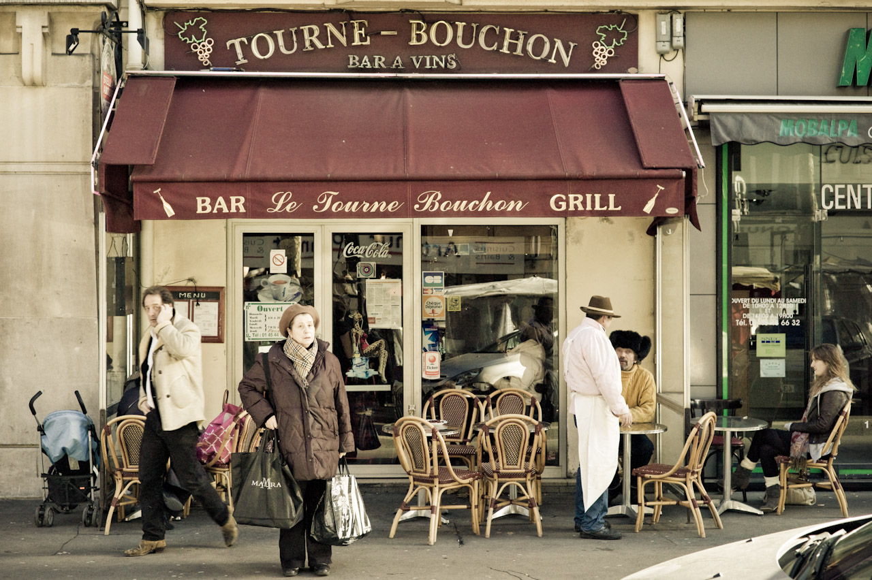
MFL
Notes:
Deeper questioning and anticipated deeper response is developed from top left to bottom right.
Get pupils to describe a variety of aspects of the photo through developing and asking quality questions and encouraging quality dialogue.
Come up with questions by choosing a word from the left-most column followed by a word from the top row.
Eg.
What Is…
How Could…
How Will…
Why might…
How Might…
ActiveX stuff and design by Jon Haines @mr_haines
Inspired by and thanks to @johnsayers

